Slide 1
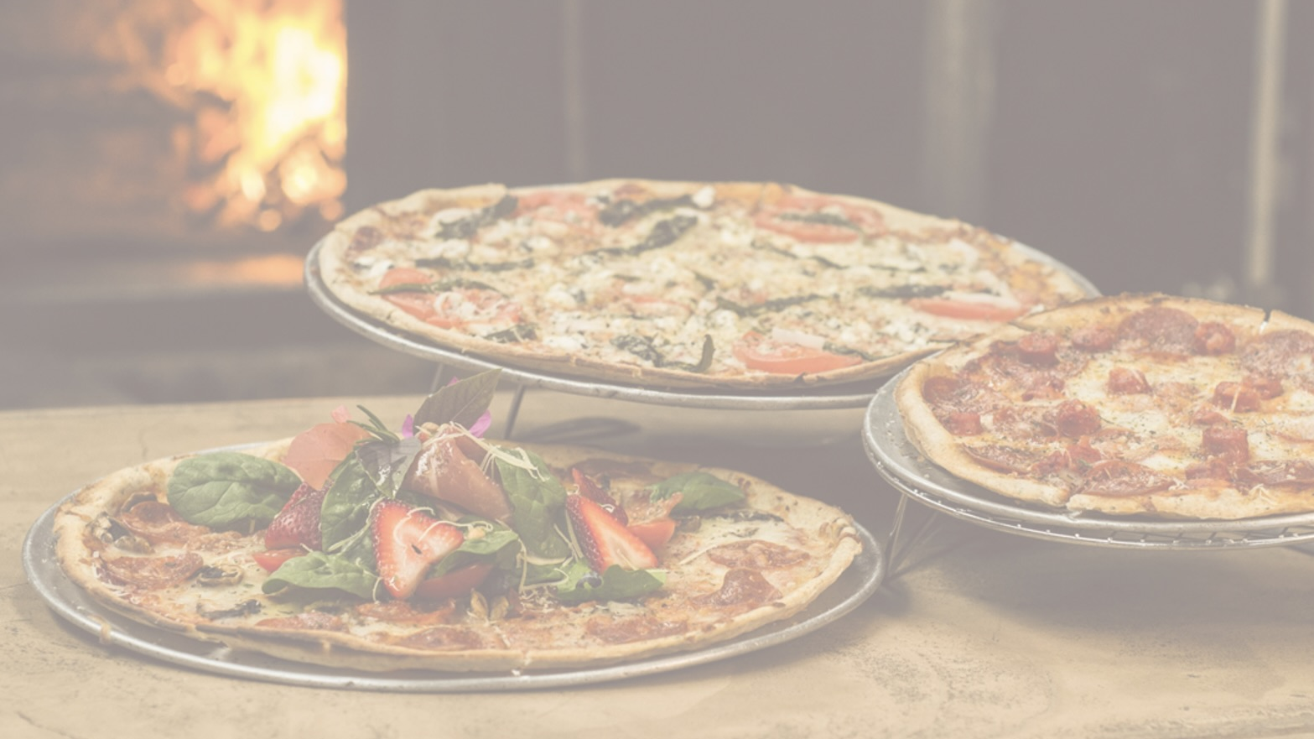
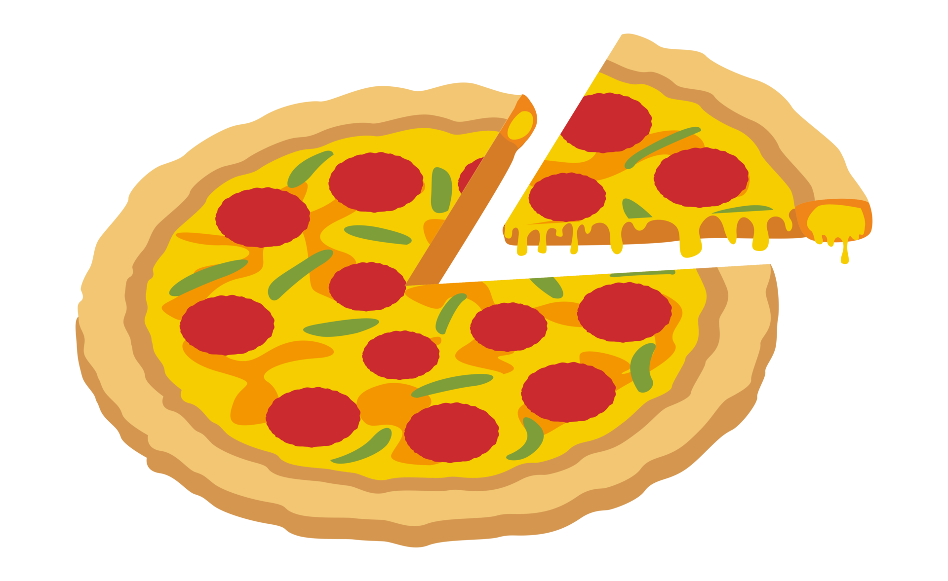
Pizzeria Project
Team: 11-6
Tymofii, Pepijn, Nikol, Shiro

Slide 2
Who did what?
We divided the tasks into backend and frontend:
Tymofii – team leader
Flask and Arduino
Pepijn
HTML & CSS
Nikol
HTML & CSS
Shiro
Flask, CSV files, GIT, and mental support

Slide 3
Tymofii
It was my first time as a group leader. I really liked this experience even though it was more responsibility and pressure.
Almost everything went more or less well – we managed to meet all the requirements and submitted everything on time. There were some problems with GIT though. Also, there was a slight lack of communication.
As for things I would do differently next time, I would like to communicate more.

Slide 4
Pepijn
I worked on making the Paper-prototype, along with working on a few tabs with HTML and CSS.
I liked working on the HTML and CSS and I thought it went decent, I had trouble using git in the beginning and I wasn’t able to help with other stuff.
Next time I would clearly choose what each of us needs to do, as well as doing more research on design beforehand.

Slide 5
Nikol
At the beginning of the project, I worked on some pages of the paper prototype. Then, after we had an idea of what the design would be I started making the design for some of the pages in HTML & CSS.
This project helped me to improve my skills in these languages because in order to make the design good-looking I did a lot of research. I am very happy with the results and I think the process of doing the pages went really well.
I had some problems when pushing files to GIT and that is the thing that did not go well but now everything is working good
Maybe the thing that I want to change next time is my communication because that would prevent two people from doing the same job and any misunderstandings.

Slide 6
Shiro
I worked on the back-end with flask. I made the flask communicate with a csv file, so that it could implement data to the web page.
Working in a group was challenging. Because I had to find my way in the group.
I can improve my group communication by asking more questions.
And most important of all. I kept the team spirit going.

Slide 7
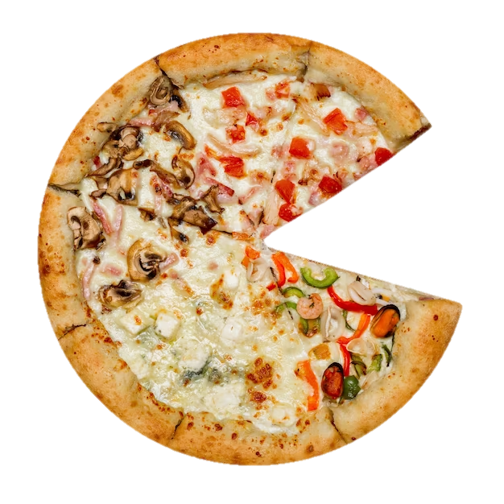
Any questions?

